Slide 1
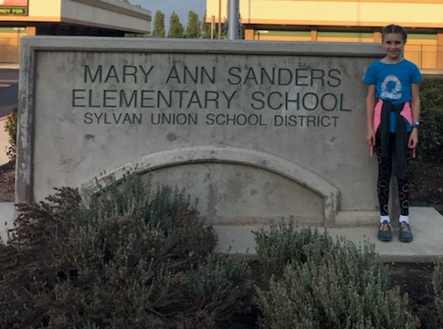
2018-19 1ST Interim Budget Report
Sylvan Union School District

Slide 2

2018-19 1st Interim Report
The 1st Interim Budget Report covers the reporting period from July 1, 2018 through October 31, 2018.
The budget projects revenues and expenditures through June 30, 2019 are based on the latest estimates and information available.

Slide 3
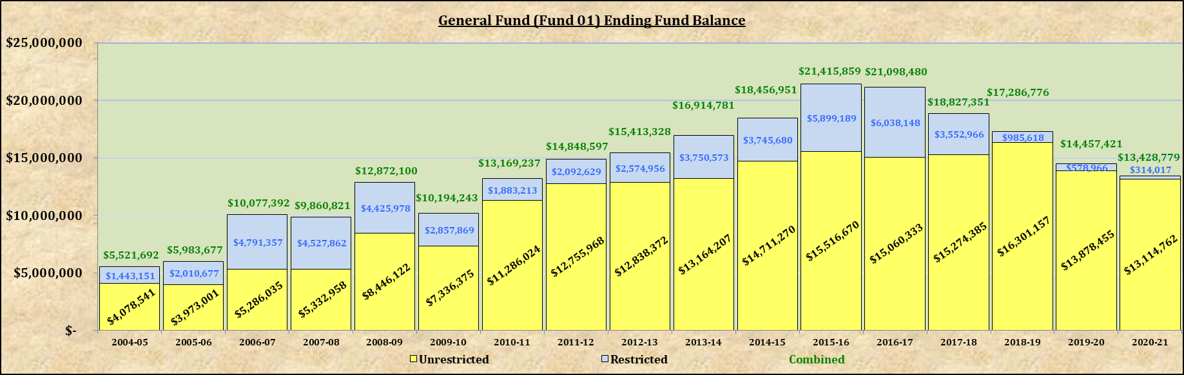
Ending Fund Balance
Historical & Projected

Slide 4
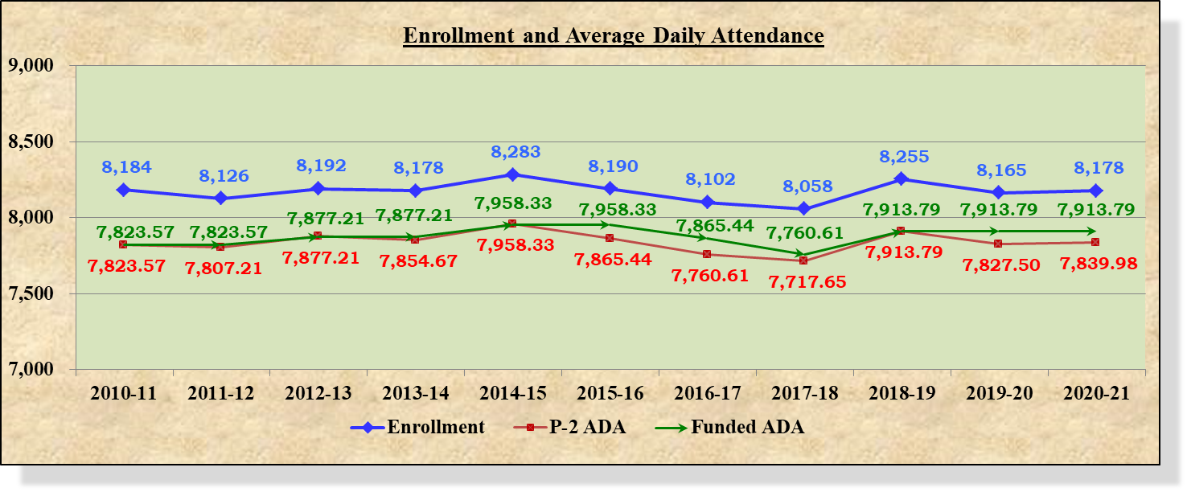
Enrollment & Average Daily Attendance
Historical & Projected
Please note:
Certified CALPADS data was submitted December 5, 2018.
Enrollment for 2018-19 reported on CBEDS date October 3, 2018 was 8,255.

Slide 5
Unrestricted EFB - Multi-Year Projection
General Finance Officers Association (GFOA) recommends, at a minimum, maintaining unrestricted reserves of no less than two (2) months of operating expenditures.
  Two (2) months of operating expenditures is approximately $14,281,594 million.
The other rule of thumb is to maintain unrestricted reserves equivalent to three (3) months of payroll which is approximately $16,938,260 million.

Slide 6
Restricted EFB – Multi-Year Projection
The 2018-19 restricted ending fund balance of $985,615 represents the following funds in Lottery Instructional Materials (RS 6300) & Ongoing & Major Maintenance Account (RS 8150)
Funds in Facilities (RS 9225) were fully expensed in 2018-19.
In fiscal year 2018-19, $1,660,530 in funds are designated for textbooks from Lottery, Instructional Materials (RS 6300) causing an increase in expenses.

Slide 7
Combined EFB – Multi-Year Projection

Slide 8
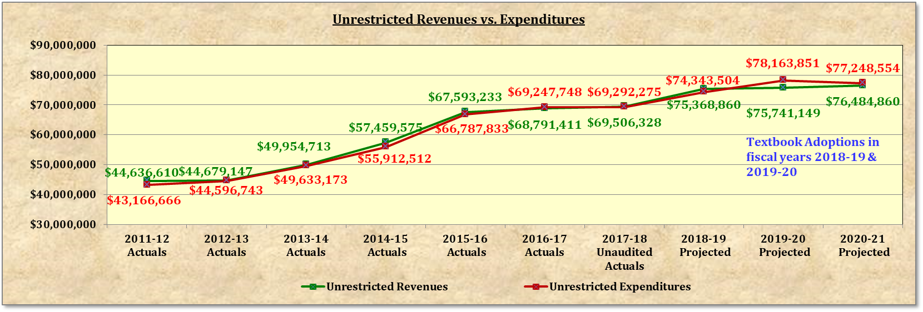
Unrestricted Revenues vs. Expenditures
The gap between revenues and expenditures widens significantly in fiscal year 2019-20 due to the textbook adoption purchase occurring that year.

Slide 9
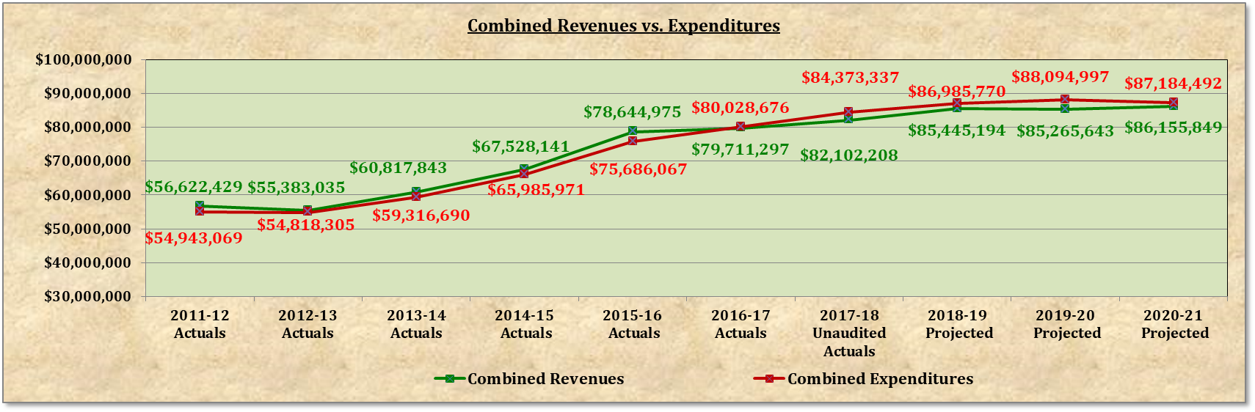
Combined Revenues vs. Expenditures
The gap between revenues and expenditures closes in 2018-19 due to the increase in LCCF funding and the movement textbook adoption expenses to be in fiscal year 2019-20 with monies from Instructional Materials Adopted Adopted/Approved (RS 0617).

Slide 10
Adopted vs. 1st Interim Budget:
Unrestricted Summary
Notes:
- The next three slides were provided in the board agenda.
- They explain the changes that were made from the Adopted budget to 1st Interim
- Here we have the Unrestricted general fund

Slide 11
Adopted vs. 1st Interim Budget:
Unrestricted Revenue
(a ) Gap funding percentage 100%; gap closed. LCCF fully implemented
(b ) Received Medical Administrative Activities (MAA) funds
(c ) One-Time Discretionary Funds decreased from $344 to $184 per ADA
(d ) Increase in major donations; Make Dreams Real , D. Hutton, YourCause & PTAs
(e ) Increased cost of Special Education service contracts

Slide 12
Adopted vs. 1st Interim Budget:
Unrestricted Expenses
(a) (b ) Positions and salaries updated
(c ) H&W premiums adjusted to reflect salary adjustments
(d ) Decrease attributed to moving textbook adoption costs from 2018-19 fiscal year to 2019-20 fiscal year
(e ) Increased costs in the following areas: advertisements, legal expenses, excess liability insurance,
physicals & TB tests, outside service contracts, & other service contracts.
(f ) Increased expenditures result in increased indirect costs.

Slide 13
Adopted vs. 1st Interim Budget:
Restricted Summary
Notes:
- This slide is looking at restricted resources

Slide 14
Adopted vs. 1st Interim Budget:
Restricted Revenue
(a ) Information provided from SCOE & SELPA for property tax
(b ) Estimated carryover to next fiscal year
(c ) Increase in funding for restricted Lottery-Instructional Materials increased from $48 to $53 per ADA.
(d ) Estimate provided from SCOE & SELPA regarding fees for services
(e ) Increase due to cost increase of Special Education service contracts & sub agreements

Slide 15
Adopted vs. 1st Interim Budget:
Restricted Expenses
(a ) (b )Positions and salaries updated
(c ) Decreased H&W premiums adjusted to reflect salary adjustments
(d ) Increase due to the following: Title I purchased chrome books. Medi-Cal incurred costs for NCS Pearson, Fun & Education. Restricted Lottery
monies were used to purchase various text books. New federal award ESEA Title IV Student Support incurred supply costs related to student safety.
(e ) "Increases in the following budget areas: - Special Ed outside services. - Mileage, legal and consultant expenses. - Travel & conferences for
professional development (PD), funding source is Title I, Medical Billing Option, & Title IV ESEA Student Support. - On-site PD and training,
funding source Title I - Restricted maintenance incurred increased costs for repairs and services for various structural improvements. - "
(f ) Orchard HVAC project completed under budget resulting in decrease of budget for permanent construction.
(g ) Estimate provided by SCOE & SELPA for transportation costs of students
(h ) Increased in restricted expenditures results in increased indirect costs

Slide 16
Adopted vs. 1st Interim Budget: Combined
Notes:
- This slide simply combines and totals the two

Slide 17
Benefit Contribution Rates

Slide 18
Combined Fund 01 – Actual Costs By Fiscal Year

Slide 19
Next Steps
Review and evaluate each budget line, revenues, expenditures, positions, salaries & benefits to project the most accurate financial information
The Governor’s 2019-20 Proposed Budget will be released in mid-January 2019
The 2nd Interim Budget Report will be delivered to the Board in March 2019
Start preparations for 2019-20 budget development

Slide 20
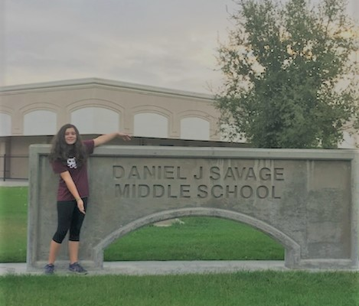
“The best way to predict your future is to create it.”
-- Abraham Lincoln
Questions?

